Slide 1

Health Information Sharing & Analysis Center
(Health-ISAC)
Errol Weiss
Chief Security Officer

Slide 2
Staying Safe On-Line
Protect Your Email
Use Multi-Factor Authentication
Keep Software Up-to-Date
Keep your systems patched and up-to-date
Think Before You Click
If it sounds too good to be true…
Windows – Settings > Update & Security
Keep your software patched and up-to-date
About
Check For Updates
And don’t forget about your mobile apps!
Apple – iTunes
Android – Play Store
Apple – Settings > General > Software Update
Android – System > Advanced > System update
Two Things
to remember

Slide 3
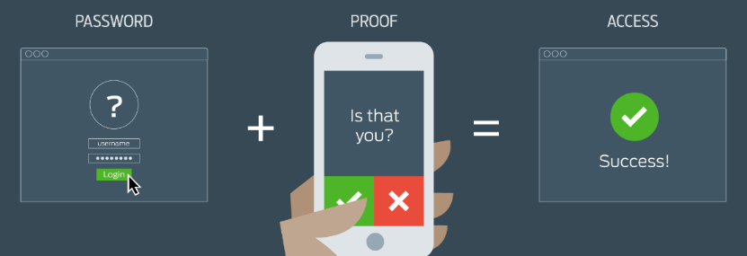
What is Multi-Factor Authentication?

Slide 4
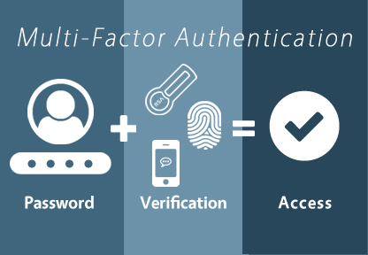
What is Multi-Factor Authentication?

Slide 5
Use Multi-Factor
(or Two-Factor) Authentication!
Financial Institutions
On-Line Retailers
Amazon
https://www.amazon.com/gp/help/customer/display.html?nodeId=201596330
Apple
https://support.apple.com/en-us/HT204152
Dropbox
https://www.dropbox.com/en/help/363
eBay
https://accounts.ebay.com/acctsec/security-center
Facebook:
https://www.facebook.com/help/148233965247823
Gmail
http://www.google.com/intl/en-US/landing/2step/features.html
Linkedin
https://www.linkedin.com/help/linkedin/answer/531?lang=en
Outlook.com
http://windows.microsoft.com/en-us/windows/two-step-verification-faq
Paypal
https://www.paypal.com/us/webapps/mpp/security/security-protections
SnapChat
https://support.snapchat.com/en-US/ca/login-verification
Twitter
https://support.twitter.com/articles/20170431#
US Postal Service (USPS)
Go to “My Preferences” then “Security” to enable 2FA
US Social Security Administration
https://secure.ssa.gov/RIL/HpsView.do#question3
Yahoo!
https://help.yahoo.com/kb/SLN5013.html

Slide 6




Learn more at www.h-isac.org

