Slide 1

SolarWinds Incident
Active Exploitation of SolarWinds Software
December 14, 2020
TLP:WHITE

Slide 2
Incident Summary
SolarWinds is being leveraged for several high-profile breaches.
CISA issued Emergency Directive to Mitigate Threat from SolarWinds Orion Network
The Cybersecurity and Infrastructure Security Agency (CISA) issued Emergency Directive 21-01, in response to a known compromise involving SolarWinds Orion products that are currently being exploited by malicious actors. The Emergency Directive calls on all US federal civilian agencies to review their networks for indicators of compromise and disconnect or power down SolarWinds Orion products immediately.
“The compromise of SolarWinds’ Orion Network Management Products poses unacceptable risks to the security of federal networks,” said CISA Acting Director Brandon Wales. “Tonight’s directive is intended to mitigate potential compromises within federal civilian networks, and we urge all our partners—in the public and private sectors—to assess their exposure to this compromise and to secure their networks against any exploitation.”
Implement recommended mitigations as soon as possible.
SolarWinds provides software for businesses to help manage their networks, systems, and IT infrastructure.
The product is used by more than 300,000 organizations globally including all five branches of the U.S. military, the Pentagon, State Department, Justice Department, NASA, the Executive Office of the President and the National Security Agency.

Slide 3
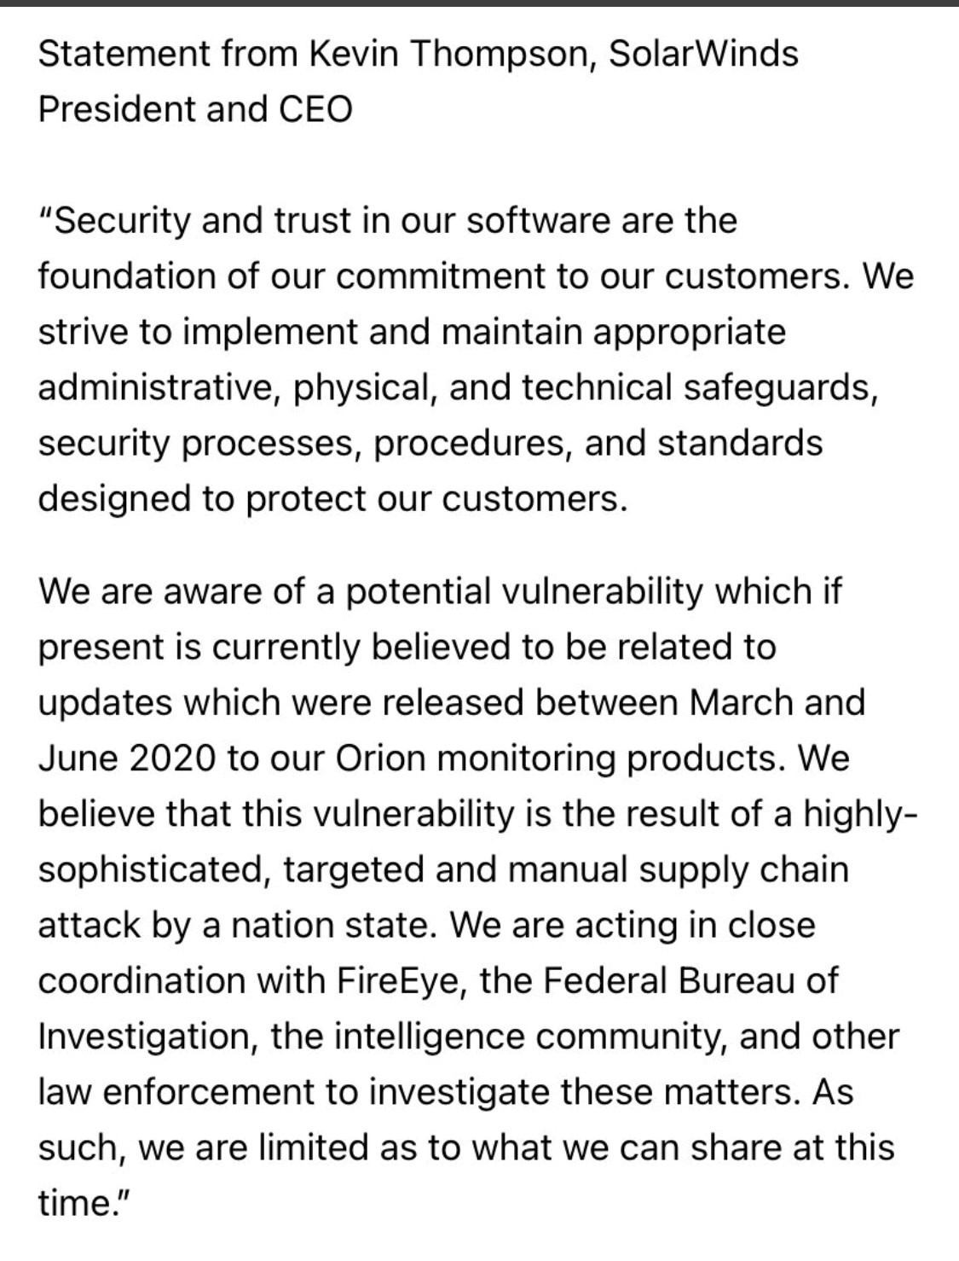
Statement from SolarWinds
SolarWinds Statement
  Kevin Thompson, President and CEO

Slide 4
Mitigation Strategies
SolarWinds recommends taking the following steps related to your use of the SolarWinds Orion Platform.
  Upgrade to Orion Platform version 2020.2.1 HF 1 as soon as possible to ensure the security of your environment. The latest version is available in the SolarWinds Customer Portal.
  If you are not sure which version of the Orion Platform you are using, see directions on how to check that here. To check which hotfixes you have applied, please go here.
  If you cannot upgrade immediately, please follow the guidelines available here for securing your Orion Platform instance. The primary mitigation steps include having your Orion Platform installed behind firewalls, disabling internet access for the Orion Platform, and limiting the ports and connections to only what is necessary.
  An additional hotfix release, 2020.2.1 HF 2 is anticipated to be made available Tuesday, December 15, 2020. We recommend that all customers update to release 2020.2.1 HF 2 once it is available, as the 2020.2.1 HF 2 release both replaces the compromised component and provides several additional security enhancements.
Health-ISAC is also recommending navigating to the countermeasures and rules that FireEye has released, which includes a trove of signatures along with other countermeasures that customers can use to detect and repel the attacks if the tools are used. Some researchers who reviewed the countermeasures said they appeared to show that the tools were not sensitive in nature.

Slide 5
SolarWinds Orion IOCs
Indicators of Compromise have been entered into Health-ISAC's automated sharing platform for those members ingesting automated threat indicators.
IOCs are being shared to WeeSecrets Mattermost IOCs channel and entered into Health-ISACs Automated Information Sharing feeds. Health-ISAC will continue to review the IOCs shared in WeeSecrets to include in our shared indicators feed.
Health-ISAC's Threat Operation Center will continue to monitor the incident, while aggregating and ingesting IOCs made available.

Slide 6
Resources
Highly Evasive Attacker Leverages SolarWinds Supply Chain to Compromise Multiple Global Victims With SUNBURST Backdoor | FireEye Inc
Russian government spies are behind a broad hacking campaign that has breached U.S. agencies and a top cyber firm
SolarWinds has just been made aware our systems experienced a highly sophisticated, manual supply chain attack on SolarWinds® Orion® Platform software builds for versions 2019.4 through 2020.2.1, released between March 2020 and June 2020.
Global Intrusion Campaign Leverages Software Supply Chain Compromise
FireEye Mandiant SunBurst Countermeasures
CISA: Active Exploitation of SolarWinds Software
CISA ISSUES EMERGENCY DIRECTIVE TO MITIGATE THE COMPROMISE OF SOLARWINDS ORION NETWORK MANAGEMENT PRODUCTS
DHS Emergency Directive 21-01: Mitigate SolarWinds Orion Code Compromise
Customer Guidance on Recent Nation-State Cyber Attacks

